Slide 1


Community Anchor Organisation Development Fund
6th February 2026
Gordon Watson & Marta Szczepanska
Sg logo

Slide 2
Background
VANL defines a Community Anchor Organisation as an organisation who are embedded in their local community with a focus on partnership working and being led by community needs. These organisations support their community through multiple, targeted supports including advice, providing local knowledge and feedback. In relation to the current round of this fund this relates to organisations who provide supports at this level across all communities within a specific locality.
In future cycles the hope would be to expand this to Community Anchor Organisations supporting communities defined by characteristics other than locality.

Slide 3
Funds Purpose
Community Anchor Organisations are a pillar of the community and voluntary sector. Through this fund, VANL wishes to support the development and growth of, and increase recognition of, Community Anchor Organisations. The aim is to support six organisations (one per locality) through:
Providing £10,000 per year for three years to support daily delivery
Receiving support from VANL to develop and integrate the services provided into the wider health and social care landscape

Slide 4
Expectations
Successful organisations would be expected to provide the following:
Informally supporting CVS organisations to engage with locality planning arms which are most appropriate to attend for that organisation, for example mental health LOIP subgroups for mental health specific organisations.
Provision of a venue for VANL locality drop in sessions and Consortia meetings.
A continued commitment to champion their community through various supports and by supporting smaller CVS groups within their locality.

Slide 5
Evaluation
Successful applicants will be provided with guidance and support to evaluate and report on their organisation.
All projects complete a yearly evaluation form which will primarily focus on case studies surrounding the supports the organisations provide both to other organisations and the communities they support.
Additionally, as a part of their evaluation and as an additional resource which a successful organisation will be able to use themselves, VANL staff will support successful applicants to produce a short video to showcase the supports their organisation provide. If a successful organisation would not like to be a part of the video element of their evaluation alternative arrangements will be discussed.

Slide 6
Application Support

Slide 7
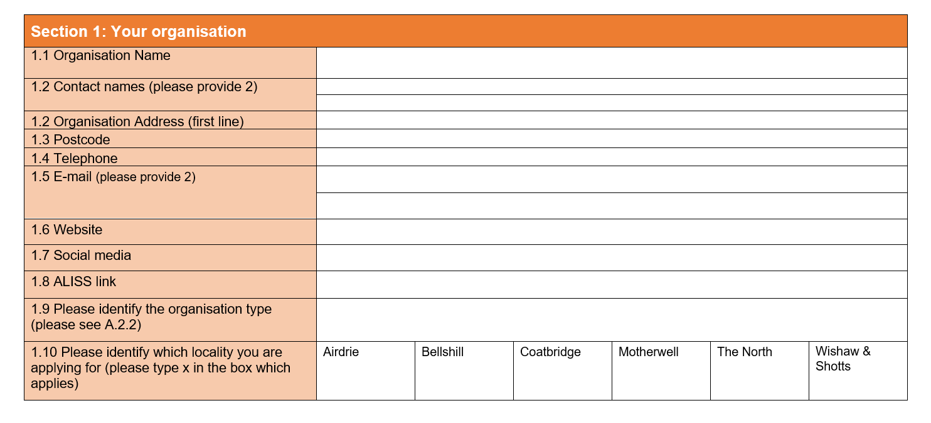
Section 1
The organisation must support/be open to all residents within the locality they are applying to within the services they provide

Slide 8
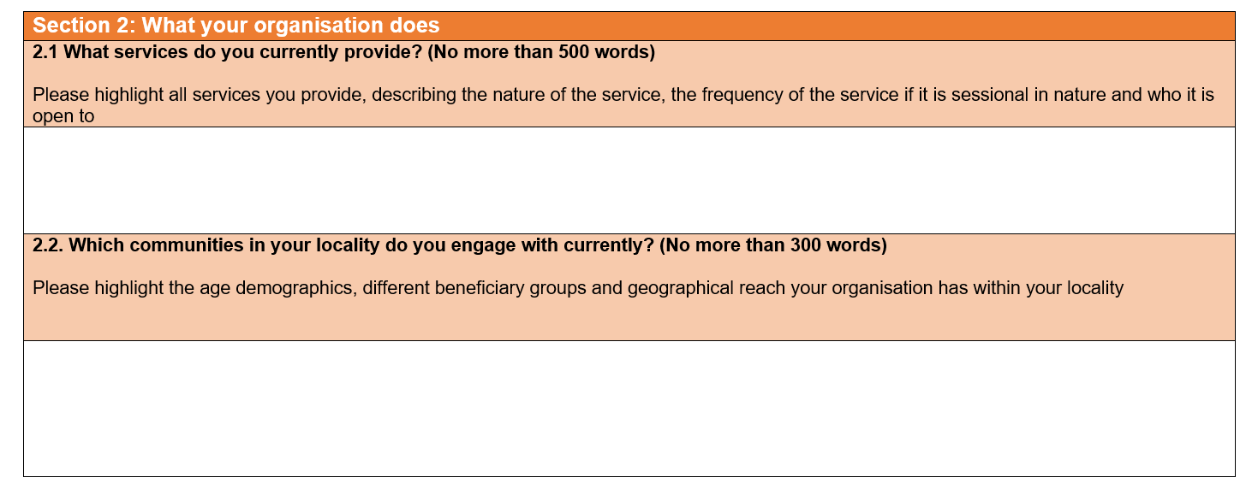
Section 2
Example-
Befriending service for men that meets fortnightly
Community Café open every day between 9-4
Which age ranges are your services open to?
If your locality has sub localities such as the villages surrounding Airdrie do you have services/attendees from this area?
Do you target specific communities with some of your services e.g. gender or condition specific services attached to your wider work

Slide 9
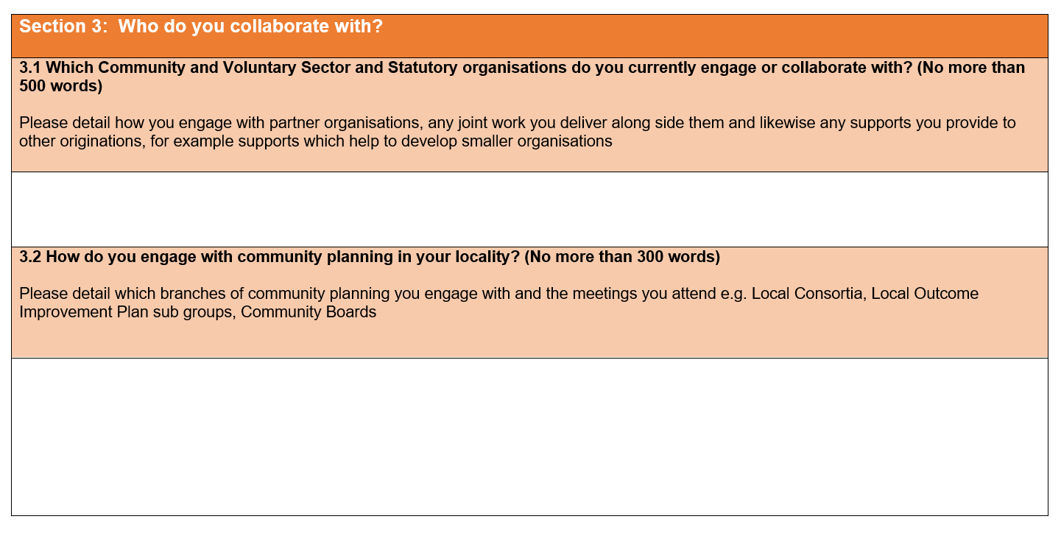
Section 3

Slide 10
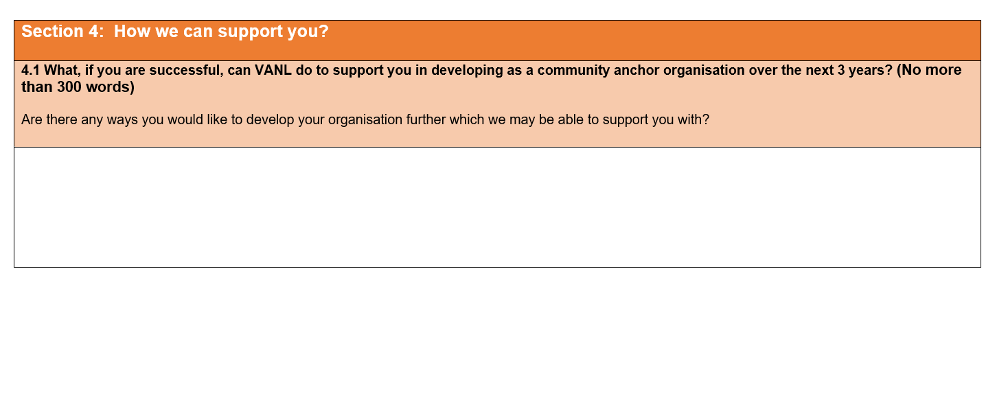
Section 4
Is there a specific area of growth you would like VANL to support your organisation through? E.g. development of a new service, support to find mainstream funding for a specific part of the services you run or help to increase the number of volunteers you have

Slide 11
Timeline
Applications Open | 2nd February
Information session | 6th February
Applications close | 20th February
Panel meeting | 10th March
Decision communication | wb 16th March
Transition month | April-May

Slide 12
Next Steps
Community Anchor Organisation Network
  Quarterly meetings
  Open to all community anchor organisations regardless of community supported
  Space to discuss challenges and issues specific to community anchor organisations
  Dates TBC after funding allocated

Slide 13
Q&A

Slide 14
Thank you!
Marta Szczepanska
Community Solutions Team Support
Marta.Szczepanska@vanl.co.uk 07985659523
Gordon Watson
Head of Community Solutions
Gordon.Watson@vanl.co.uk 07874886310

