Slide 1
COMMUNITY SOLUTIONS
AIRDRIE LOCALITY
CONSORTIUM
Airdrie Locality
Hosted By

Slide 2
About The Consortium
Airdrie Locality
Consortium
Your community or voluntary sector organisation could be eligible to apply for up to £3000 to deliver a proposal which supports key health and social care outcomes across Airdrie and surounding villages.
WHAT ARE THE KEY OBJECTIVES?
The purpose of Community Solutions is to improve and maintain health and wellbeing, strengthen social connection and support and reduce isolation and loneliness amongst adults, carers and children, young people and families in North Lanarkshire.

Slide 3
About
Diamonds in the Community
WHO ARE DIAMONDS IN THE COMMUNITY?
A charity formed in 2019 who operate various social inclusion
services including;
ARTS GROUP
BREAKFAST & BLETHER
BOCCIA
CHIT CHAT CAFE
FOOTBALL MEMORIES GROUP
WALK & TALK GROUP
WALKING FOOTBALL
with approximately 180-200 residents attending weekly...

Slide 4
About
Diamonds in the Community
WE ALSO OFFER VARIOUS RECYCLING SERVICES TO BENEFIT OUR LOCAL
COMMUNITY AND OTHERS FURTHER AFIELD...

Slide 5
About
Diamonds in the Community
We also operate the Monklands Baby & Family Clothing Aid service, offering practical support for local individuals and families experiencing times of difficulties with providing clothing, shoes, baby equipment, household essentials, furniture and white goods.
In 2024 we completed 591 referrals, helping assist over 1300 people, a figure that we expect to surpass in 2025.

Slide 6
About
Diamonds in the Community

Slide 7
About
Diamonds in the Community

Slide 8
About
Diamonds in the Community

Slide 9
About
Diamonds in the Community

Slide 10
About
Diamonds in the Community

Slide 11
Airdrie Locality
Consortium
COMMUNITY SOLUTIONS
AIRDRIE LOCALITY
CONSORTIUM
Hosted By

Slide 12
COMMUNITY SOLUTIONS
AIRDRIE LOCALITY
CONSORTIUM
LOCAL ACTIVITY FUND
WHO CAN APPLY FOR FUNDING?
Not-for-profit community groups (including but not exclusively charities, SCIOs, social enterprises and unincorporated associations) operating or providing services within Airdrie and surrounding villages can apply for a grant of up to £3,000 to deliver a proposal which advances the Community Solutions agenda locally.
Hosted By

Slide 13
COMMUNITY SOLUTIONS
AIRDRIE LOCALITY
CONSORTIUM
LOCAL ACTIVITY FUND
HERE ARE SOME EXAMPLES
OF RECENT SUCCESFUL
FUNDING BIDS....
Hosted By

Slide 15
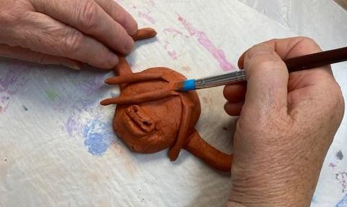
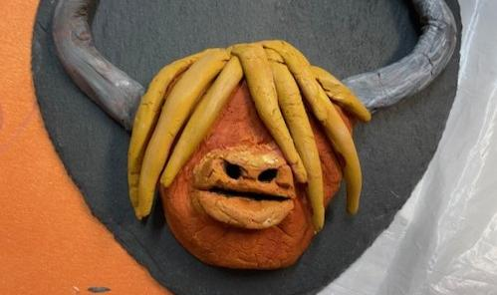
Past Funding Example 1
Airdrie Locality
Consortium
Clay Art Workshop
2024
Very therapeutic sessions, they have allowed me to gain new skills. I enjoyed using my hands and loved the ability to be creative. I felt really zoned in during the process, it allowed me to focus on something whilst having a sense of calm and definitely a sense of achievement at the end. I had to be patient and accept imperfection, both of which I struggle with but it didn’t feel so at the time. Kristine was great and I loved that she started the session off with a meditation. Fantastic experience!

Slide 16
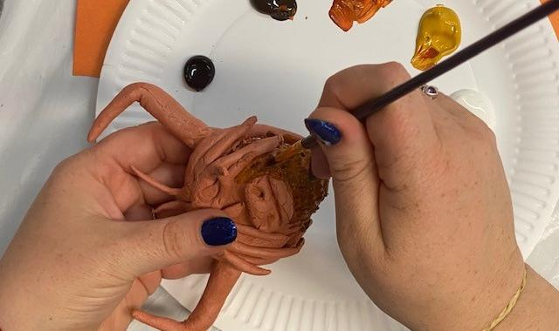
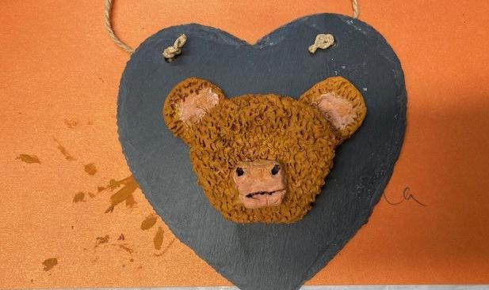
Past Funding Example 1
Airdrie Locality
Consortium
Clay Art Workshop
2024
The Pottery class was absolutely fantastic as it helped me to calm down and concentrate and I achieved something in my life, no stress which was wonderful as my life has been so difficult to deal with.
Being able to work with clay was amazing – it had a calming effect on me. I could put my anxiety and stress aside. Very enjoyable and mindful! I would certainly enjoy similar art therapy!

Slide 18
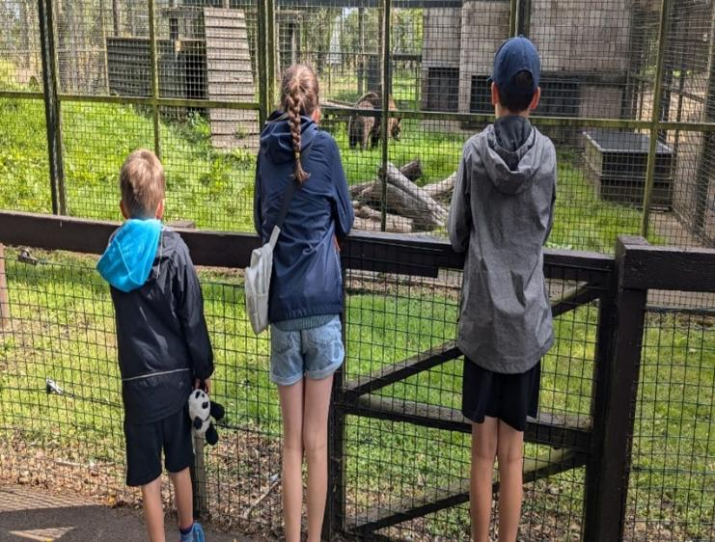
Past Funding Example 2
Airdrie Locality
Consortium
Five Sisters Zoo Trip
2024
Our recent summer trip to The Five Sisters Zoo was a rousing success with over 100 people from the HOPE Family attending. This included new members, staff, friends and family.
The day allowed our young people to create new memories by meeting new friends, bonding with others and getting close to over 160 Cool species of Animals!

Slide 19
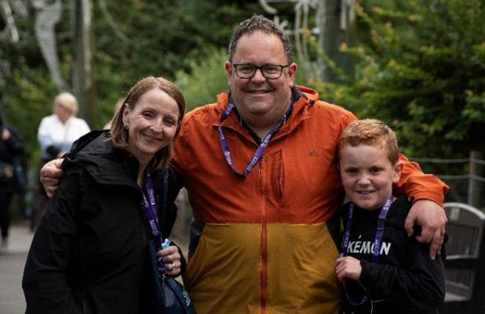
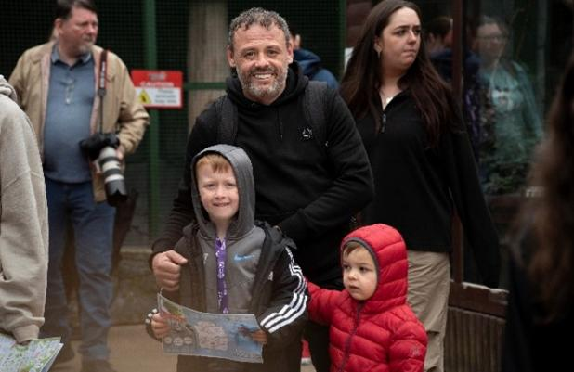
Past Funding Example 2
Airdrie Locality
Consortium
Five Sisters Zoo Trip
2024
We would like to thank the Consortia for their support. The benefits of this trip have lasted much longer than one day. Friendships and support links have been formed. Families and children have gained the confidence and have been inspired to join different groups and services after conversations with other families, staff members and volunteers. This has been, without a doubt, the best summer trip yet!

Slide 20
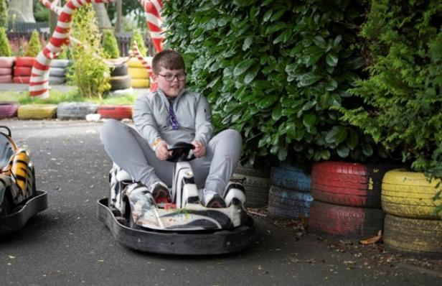
Past Funding Example 2
Airdrie Locality
Consortium
Five Sisters Zoo Trip
“We all had a great Day thanks, It was so nice to see …… so relaxed and having fun on a trip!”
2024
“Thanks again for a lovely day! The kids really enjoyed their day! You all do a fantastic job of planning and organising events and activities!”

Slide 22
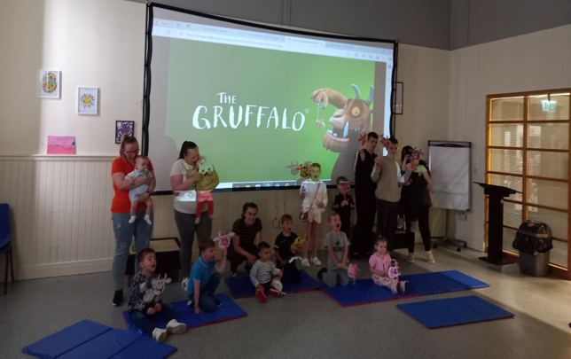
Past Funding Example 3
Airdrie Locality
Consortium
Summer Holiday Film Clubs
2024
The movie was very engaging for the kids, nice and short
I really enjoyed the movie a great film for families, perfect amount of time, the kids enjoyed it

Slide 23
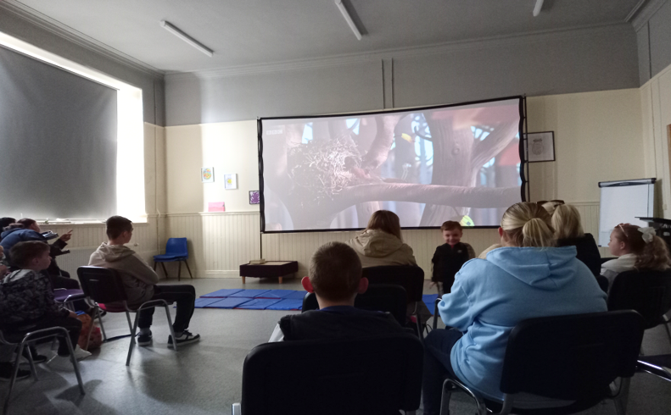
Past Funding Example 3
Airdrie Locality
Consortium
Summer Holiday Film Clubs
I really enjoyed sitting watching the movie
2024
The activities were very fun and loads to choose from

Slide 25
Past Funding Example 4
Airdrie Locality
Consortium
Breakfast & Blether
2024
THANK YOU
for today .... seriously thank you :)

Slide 26
Past Funding Example 4
Airdrie Locality
Consortium
Felt incredibly confortable on my first visit
Breakfast & Blether
2024
Felt incredibly comfortable on my first visit

Slide 28
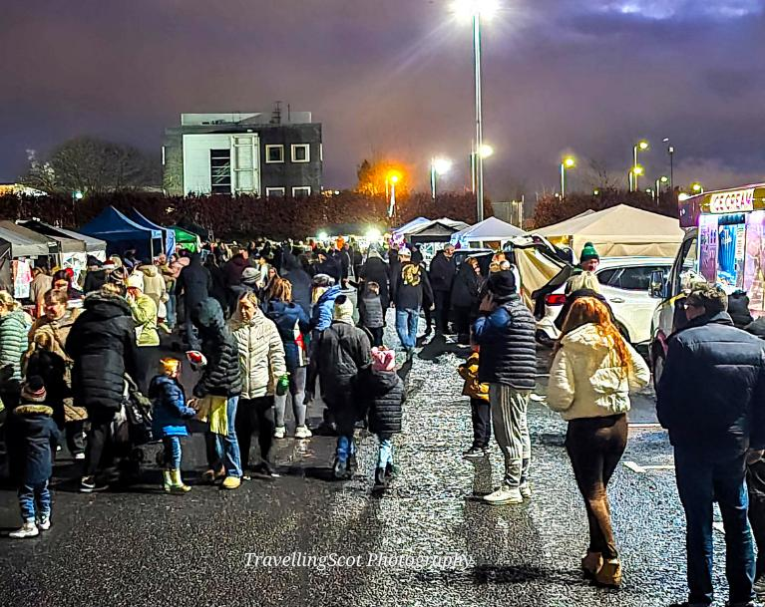
Past Funding Example 5
Airdrie Locality
Consortium
Santa’s Market &
Drive-in Movie events
2024
This was an absolutely amazing night for the community of Chapelhall, everyone really enjoyed themselves and people went above and beyond for this event. The choir was amazing and made the full event exceptional. I was really impressed.

Slide 29
Past Funding Example 5
Airdrie Locality
Consortium
Santa’s Market &
Drive-in Movie events
Amazing experience for children in the village. Something on our doorstep to attend.
2024
It was great to have something like this within walking distance. Great for the village and the kids had a ball.

Slide 30
Airdrie Locality
Consortium
THANK YOU
FOR WATCHING
COMMUNITY SOLUTIONS
Airdrie Locality
AIRDRIE LOCALITY
CONSORTIUM

